Slide 1
4.1 – 4.4 (a) Objects and Classes
ITP3914 – Programming
Part 4 – Programming with Objects and Classes

Slide 2

Part 1 – Defining, Creating, and Using Objects

Slide 3
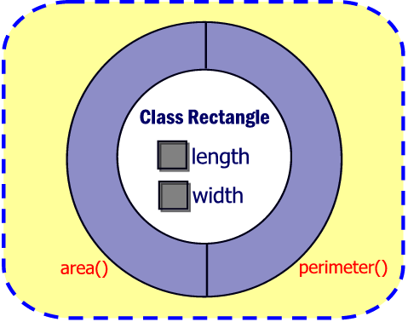
The Rectangle Class
Don’t ask me what “private” and “public” means by now.
public class Rectangle {
private double length;
private double width;
public double area()
{
return length * width;
}
public double perimeter()
{
return (length + width) * 2;
}
}
Instance Variables
Method area()
Method perimeter()
Note that only the class is defined. No actual object instance has been created so far.

Slide 4
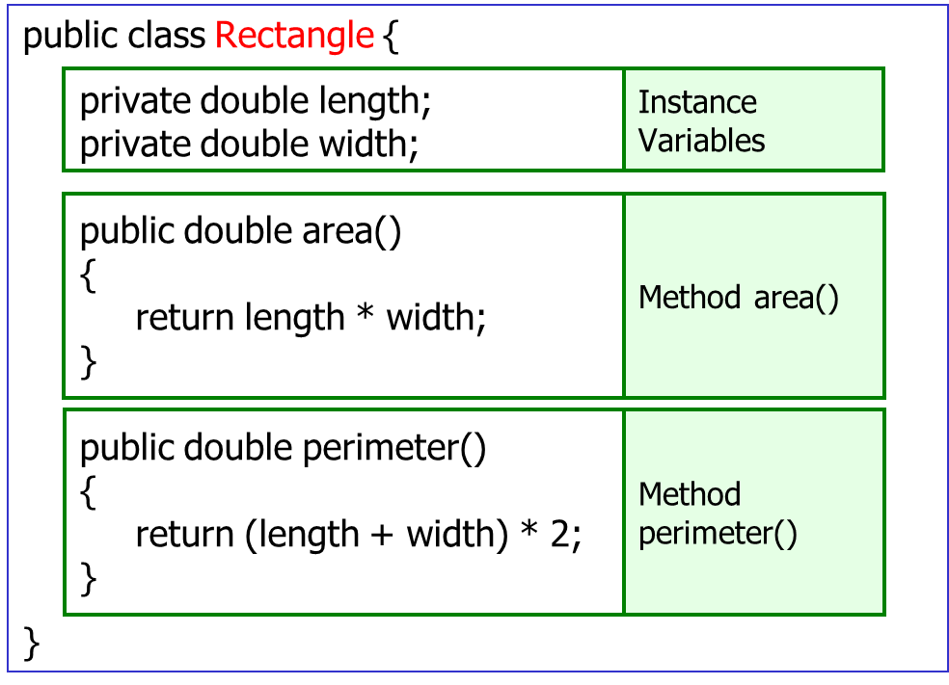
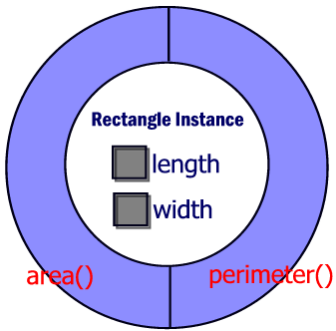
Creating Rectangle Objects
We need to have another Java program to create the object instances and instruct them to work.
Object
Instantiation

Slide 5
The RectangleUser Class
Object Instantiation
Two objects of class Rectangle are created.
Referenced by r1 and r2.
public class RectangleUser {
public static void main(String [] argv)
{
Rectangle r1= new Rectangle( );
Rectangle r2= new Rectangle( );
double area;
area = r1. area();
System.out.println("r1 area " + area);
area = r2.area();
System.out.println("r2 area " + area);
}
}
r1
r2
Calling the area() Method
Sends a message to r1.
Request r1 to perform area().
The method then calculates and returns the area of r1.

Slide 6
Constructors
public class Rectangle {
private double length;
private double width;
public Rectangle( )
{
length =0;
width = 0;
}
public double area()
{
return length * width;
}
}
Constructor Rectangle( )
Constructor: Rectangle( )
Same name as the class.
Automatically called when an object is instantiated.
Used to set up the object instance upon its creation.
For example, initializing instance variables.

Slide 7
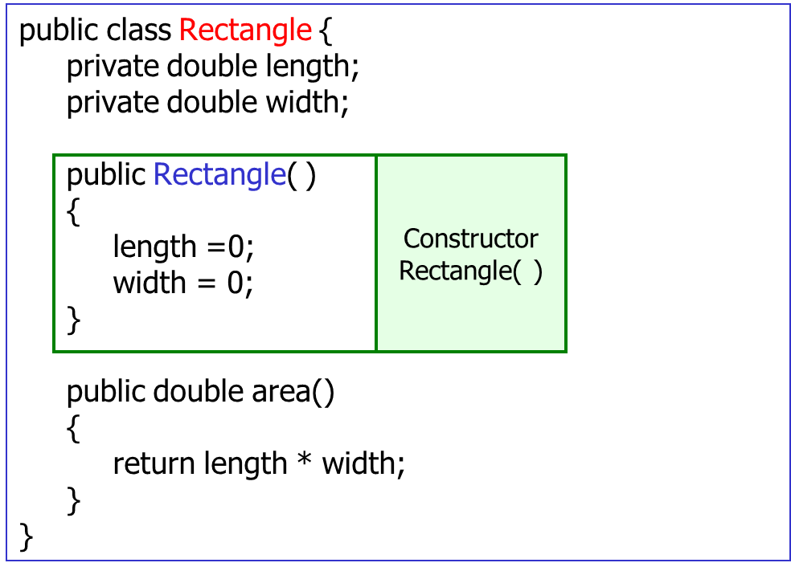
Instantiation – Calling constructor
public class RectangleUser {
public static void main(String [] argv)
{
Rectangle r1 = new Rectangle( );
Rectangle r2 = new Rectangle( );
double area;
area = r1.area();
System.out.println("r1 area=" + area);
area = r2.area();
System.out.println("r2 area=" + area);
}
}
Object Instantiation
Two objects of class Rectangle are created.
Referenced by r1 and r2.
The statement: new Rectangle()
actually means that the constructor is called.

Slide 8
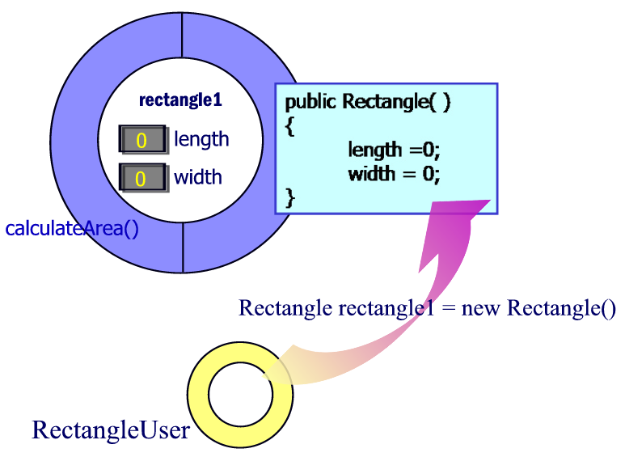
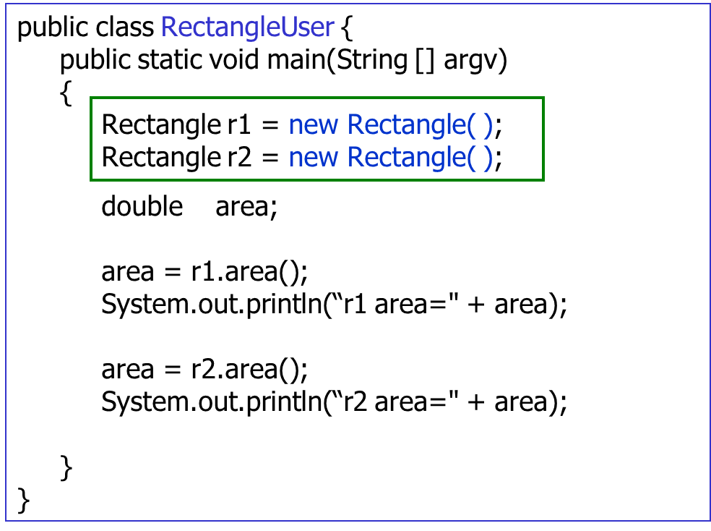
r1
area()
Rectangle r1 = new Rectangle()
Object instantiation of r2 is similar.

Slide 9
Constructor again
public class Rectangle {
private double length;
private double width;
public Rectangle(double l, double w)
{
length = l;
width = w;
}
public double area()
{
return length * width;
}
}
Constructor Rectangle()
Constructor: Rectangle(double l, double w)
Constructor is a method, thus can take parameters.
The parameters are usually used to initiate instance variables.

Slide 10
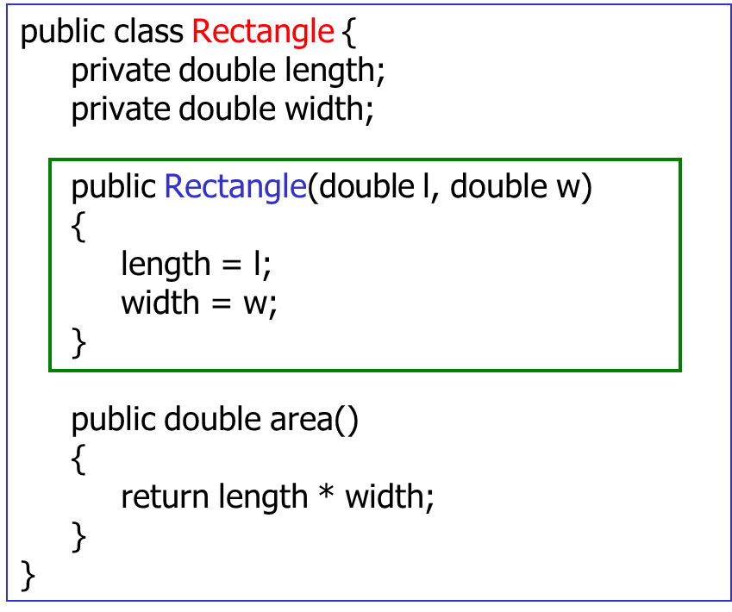
Calling constructor with parameters
public class RectangleUser {
public static void main(String [] argv)
{
Rectangle r1= new Rectangle(30, 10);
Rectangle r2= new Rectangle(25,20);
double area;
area = r1.area();
System.out.println("r1 area " + area);
area = r2.area();
System.out.println("r2 area " + area);
}
}
l
30
w
10

Slide 11
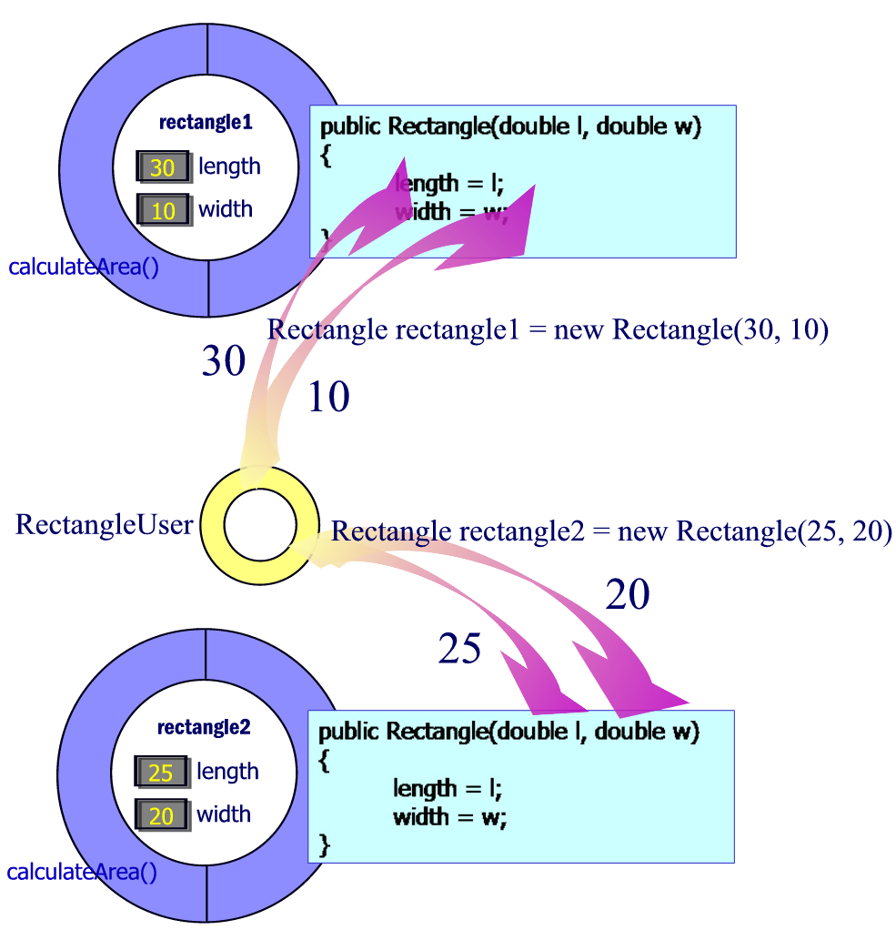
r1
area()
Rectangle r1 = new Rectangle(30, 10);
Rectangle r2 = new Rectangle(25, 20);
r2
area()

Slide 12

Constructor – more details
public class Rectangle {
private double length;
private double width;
public Rectangle(double l, double w)
{
length = l;
width = w;
}
…..
}
No return type here
Constructors can take arguments but cannot return a value.
Constructors are NOT allowed to specify a return type (NOT EVEN void).

Slide 13
No-Argument Constructors
A no-argument constructor takes no argument, e.g. public Rectangle()
If no constructors are defined for a class, then compiler (javac) creates a default constructor which is a no-argument constructor.
If constructors are defined for a class, but none of them are no-argument constructors, an attempt to create an object instance using no-argument constructor will cause a syntax error.
That is, you can call a no-argument constructor if:
You have defined a no-argument constructor for the class, or
You have defined no constructor at all (then one is provided by javac).

Slide 14
Overloading Constructors
public class Rectangle {
private double length;
private double width;
public Rectangle()
{
length = 0;
width = 0;
}
public Rectangle(double l, double w)
{
length = l;
width = w;
}
…..
}
A no-argument constructor
The appropriate constructor is invoked by matching the number, types and order of
the arguments specified in
the constructor call with
those defined in the signature.
A constructor can be overloaded (that is, several constructors
exists in the same class, but with different signatures).
public class RectangleUser {
public static void main(String [] argv)
{
Rectangle r1 = new Rectangle();
Rectangle r2 = new Rectangle(25.3, 20.4);
…
}
}

Slide 15
public class Rectangle {
private double length;
private double width;
public Rectangle() {
length = 0;
width = 0;
}
public Rectangle(double l, double w) {
length = l;
width = w;
}
public double area() {
return length * width;
}
public static void main(String [] args) {
Rectangle r1 = new Rectangle();
….
}
}
If you wish, you can put both object definition and main() in the same class.

Slide 16
Part 2 – Access Specifiers

Slide 17
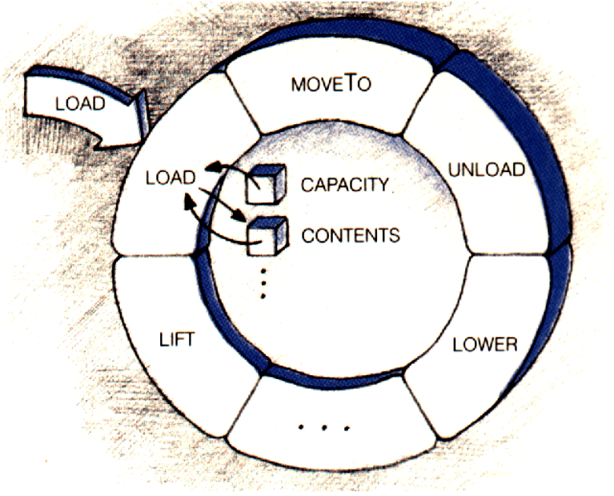
Revision - Encapsulation
Packaging related data and procedures together is called encapsulation.
In the OO approach, the data inside an object is accessed only by the object’s method.
“Users” of the object must call the object’s method for getting or setting the object’s instance variables indirectly.
This protects the instance variables from being in an inconsistent or unreasonable state.

Slide 18
Types of Access Specifiers
public class Rectangle {
private double length;
private double width;
…..
}
Instance Variables
private double length;
Access specifier
Data type specification
Variable name

Slide 19
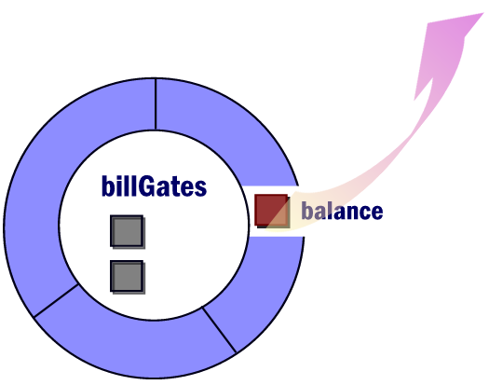
public Instance Variables
public instance variables can be used by anyone.
No encapsulation!
No protection!
public class BankAccount {
public double balance = 99999999999;
…..
}
public class Thief {
public static void main(String [] argv)
{
BankAccount billGates = new BankAccount();
billGates.balance = 0;
…
}
}

Slide 20
private Instance Variables
public class Rectangle {
private double length;
private double width;
…..
}
length is private
and cannot be accessed outside the class.
public class RectangleUser {
public static void main(String [] argv)
{
Rectangle r1 = new Rectangle(25.3, 20.4);
System.out.println( r1.length);
…
}
}
RectangleUser.java:5: length has private access in Rectangle
r1.length
^

Slide 21
Getter methods
In order to access private variables, a public getter method is provided.
The getter method simply returns the value of the private variable.
By convention, a getter method has a name getXXX() where XXX is the variable name.
public class Rectangle {
private double length;
private double width;
…..
public double getLength() {
return length;
}
public double getWidth() {
return width;
}
}
Getter for length
Getter for width
public class RectangleUser {
public static void main(String [] argv)
{
Rectangle r1 = new Rectangle(25.3, 20.4);
System.out.println( r1.getLength() );
…
}
}

Slide 22

Setter Methods
public class Student {
private int score=0;
…..
public void setScore( int value )
{
if (value >= 0 && value <= 100)
score = value;
else
System.out.println("Invalid value");
}
}
Setter for score
Protects variable score from storing invalid values.
public class Teacher {
public static void main(String [] argv)
{
Student peter = new Student();
peter.setScore(60);
…
}
}
Can you tell me the benefits of using a setter method?

Slide 23
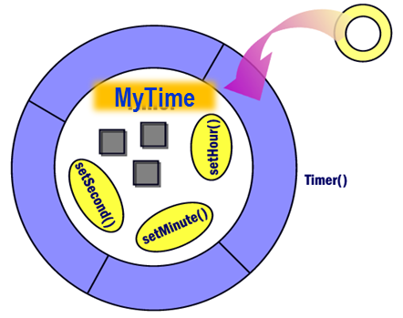
private Methods
import java.text.DecimalFormat;
public class MyTime {
private int hour;
private int minute;
private int second;
public MyTime() {
setTime(0, 0, 0);
}
public void setTime(int h, int m, int s) {
setHour(h);
setMinute(m);
setSecond(s);
}
private void setHour(int h) {
if (h>=0 && h<=23)
hour = h;
}
private void setMinute(int m) {
if (m>=0 && m<=59)
minute = m;
}
private void setSecond(int s) {
if (s>=0 && s<=59)
second = s;
}
public void printTime() {
DecimalFormat twoDigits = new DecimalFormat("00");
System.out.println(
twoDigits.format(hour) + ":" +
twoDigits.format(minute) + ":" +
twoDigits.format(second)
);
}
public static void main(String [] args) {
MyTime t = new MyTime();
t.printTime();
t.setTime(13, 27, 6);
t.printTime();
t.setTime(99, 00, 00);
t.printTime();
}
}
C:\> java MyTime
00:00:00
13:27:06
13:00:00
Access specifiers are used both for instance variables and methods.
private methods can only be called from inside the object.

Slide 24

END.

